Slide 1
Mapping the Educational Landscape
Project By:
BAIG MANZOOR

Slide 2
Project Objective
The objective of the “Data analytics Of College Analysis” project is to perform a comprehensive analysis of the features, ratings, and fees of colleges listed on the Careers 360 platform across India.
By analyzing the data, this project aims to uncover student preferences, regional fee variations, and the growing demand for specific courses. The insights are designed to optimize institutional strategies, enhance marketing efforts, and improve the overall competitiveness of colleges in the Indian education ecosystem.
The data was sourced from the Careers 360 website using Python-based web scraping techniques, extracting detailed datasets for analysis.

Slide 3
Main Agenda
1. Data collection through web scraping and open datasets.
2. Data cleaning, preprocessing, and modelling in Python Using Visual Studio.
3. Creating impactful visualizations in Power BI to uncover actionable insights.
An in-depth exploration of web scraping and data visualization using Python on the “Careers 360" website, focusing on retrieving data from colleges across India. This project highlights the power of extracting, analyzing, and visualizing data to provide actionable insights into the Indian higher education landscape.

Slide 4
Tools and Technologies
Software Requirements
1. Excel
2. Python (Visual Studio)
3. Power BI
Main Software Libraries
1. Beautiful Soup
2. Requests
3. Openpyxl

Slide 5
Introduction
Overview of project:
Data collection through web scraping. Data cleaning, preprocessing, and modelling in Python Using Visual Studio. Creating impactful visualizations in Power BI to uncover actionable insights.
Importance of Analyzing Engineering Colleges Data:
Understanding engineering college data is critical to identifying trends, analyzing fee structures, student preferences, course popularity, and regional variations.
Importance of web scraping and data preprocessing and data visualization:
Web scraping is used to extract the data form the websites. Visualization tools like Power Bi make complex datasets easier to understand and communicate, enabling data-driven decision-making.

Slide 6
Web Scraping
Step 1: Importing Libraries
import requests # HTTP requests :-web scraping or interacting with web
from bs4 import Beautiful Soup # HTML parsing using Beautiful Soup : pulling data out of HTML and XML files and searching and modifying phrase tree
import openpyxl # The openpyxl library in Python is used for working with Excel files
from openpyxl import Workbook # The Workbook class from openpyxl is used to create a new Excel workbook
Step 2 : Opening Excel Sheet
excel = openpyxl.Workbook() # Opening the new workbook
sheet = excel.active # setting up the active sheet to add the data
Step 3 :Adding columns names to the sheet
sheet.append(["College Name","Location","State","Entrance Exam","Fees","Rating","College Affiliation", "Course Name", "Available Courses"]) # appending column names in the active sheet

Slide 7
.
Step 4 : CHECKING THE ACCESS OF URL
headers = {'User-Agent': 'Mozilla/5.0 (Windows NT 10.0; Win64; x64) AppleWebKit/537.36 (KHTML, like Gecko) Chrome/116.0.0.0 Safari/537.36 Edg/116.0.1938.54'}
Step 5 : URL TO EXTRACT THE DATA USING SOUP OBJECT
Hyderabad_colleges = requests.get("https://engineering.careers360.com/colleges/list-of-engineering-colleges-inindia?entity_type=2&sort_by=3&degree=2&state=25&city=950%2C1365%2C59%2C97%2C73%2C72%2C1253%2C101%2C25979%2C2358%2C359%2C450%2C128%2C936%2C919&stream=1",headers=headers)
Hyd = BeautifulSoup(Hyderabad_colleges.text, "html.parser") # colleges in Hyderabad
Andhra_Colleges = requests.get("https://engineering.careers360.com/colleges/list-of-engineering-colleges-in-india?entity_type=2&sort_by=3&degree=2&state=1&city=51%2C142%2C395%2C1357%2C1313%2C70%2C248%2C12%2C346%2C219%2C510%2C143%2C341%2C125%2C1173%2C817%2C979%2C1150%2C1227%2C416&fee=500000&stream=1",headers=headers)
Ap = BeautifulSoup(Andhra_Colleges.text, "html.parser") # colleges in Andhra Pradesh
Kerala_colleges = requests.get("https://engineering.careers360.com/colleges/list-of-engineering-colleges-in-india?entity_type=2&sort_by=3&degree=2&fee=1000000&state=13&city=131%2C6%2C77%2C43%2C340%2C102%2C1032%2C410%2C133%2C80%2C284%2C312%2C318%2C86%2C509&stream=1",headers=headers)
Kerala = BeautifulSoup(Kerala_colleges.text, "html.parser") # colleges in Kerala

Slide 8
Karnataka_colleges = requests.get("https://engineering.careers360.com/colleges/list-of-engineering-colleges-inindia?entity_type=2&sort_by=3&degree=2&fee=1000000&state=12&city=715%2C19%2C4347%2C95%2C948%2C711%2C88%2C10858%2C1109%2C1312%2C162%2C24944%2C167%2C26%2C278&stream=1",headers=headers)
Karnataka = BeautifulSoup(Karnataka_colleges.text, "html.parser") # colleges in Karnataka
Maharastra_colleges = requests.get("https://engineering.careers360.com/colleges/list-of-engineering-colleges-in-india?entity_type=2&sort_by=3&degree=2&fee=1000000&state=15&city=41038%2C110%2C1138%2C96%2C98%2C337%2C14%2C123%2C1156%2C9%2C1210%2C129%2C288%2C432%2C3595&stream=1",headers=headers)
Maharastra = BeautifulSoup(Maharastra_colleges.text, "html.parser") # colleges in Maharashtra
Delhi_colleges = requests.get("https://engineering.careers360.com/colleges/list-of-engineering-colleges-in-india?entity_type=2&sort_by=3&degree=2&fee=1000000&city=48%2C100%2C89%2C124%2C44%2C436%2C67%2C151%2C24%2C402%2C404%2C2553%2C29%2C316%2C361&state=43&stream=1",headers=headers)
Delhi = BeautifulSoup(Delhi_colleges.text, "html.parser") # colleges in Delhi
Uttar_pradesh_colleges = requests.get("https://engineering.careers360.com/colleges/list-of-engineering-colleges-in-india?entity_type=2&sort_by=3&degree=2&fee=1000000&city=48%2C89%2C29%2C82%2C927%2C178%2C993%2C7%2C1130%2C1168%2C193%2C1%2C90%2C139%2C5061&state=28&stream=1",headers=headers)
Uttar_pradesh = BeautifulSoup(Uttar_pradesh_colleges.text, "html.parser") # colleges in Uttar Pradesh

Slide 9
Harayana_colleges = requests.get("https://engineering.careers360.com/colleges/list-of-engineeringcollegesindia?entity_type=2&degree=2&fee=1000000&city=124%2C44%2C145%2C347%2C436%2C67%2C905%2C24%2C14%2C934%2C402%2C5405%2C404%2C8%2C122&state=8&stream=1",headers=headers)
Harayana = BeautifulSoup(Harayana_colleges.text, "html.parser") # colleges in Haryana
Step 6: Extracting all the Colleges from the path
hyd_colleges = Hyd.find("body").find("div",class_="undefined").find_all("div")
Step 7: Using for Loop to extract all the details of college
for hyd_college in hyd_colleges:
try:
name = hyd_college.find("div",class_="tupple").find("h3").find("a").text.split(",")[0] # To extract name of college
location = hyd_college.find("div",class_="tupple").find("h3").find("a").text.split(",")[-1] # To extract location of college

Slide 10
.
state = hyd_college.find("div",class_="content_block d-none d-md-block d-md-flex flex-row justify-content-between").find("span").text.split(",")[1] # To extract state of college
entrance_exam = hyd_college.find("li").find("a").text # To extract entrance exam of college
Fees=hyd_college.find("div",class_="snippet_block").find("ul",class_="snippet_list").find_all("li")[1].text.split("₹")[1].split(" ")[0] # To extract fees of college
Rating = float(hyd_college.find("div",class_="content_block d-none d-md-block d-md-flex flex-row justify-content-between").find("span",class_="star_text").find("b").text.split("/")[0]) # To extract Rating of college
College_Affiliation = hyd_college.find("div",class_="content_block d-none d-md-block d-md-flex flex-row justify-content-between")\.find("div").find_all("span")[1].text # To extract college affiliation of college
course=hyd_college.find("div",class_="snippet_block").find("ul",class_="snippet_list").find_all("li")[2].text.split("(")[0] # To extract course of college
no_course=int(hyd_college.find("div",class_="snippet_block").find("ul",class_="snippet_list").find_all("li")[2].find("span").text.split("(")[1].split(" ")[0]) # To extract no of courses of college

Slide 11
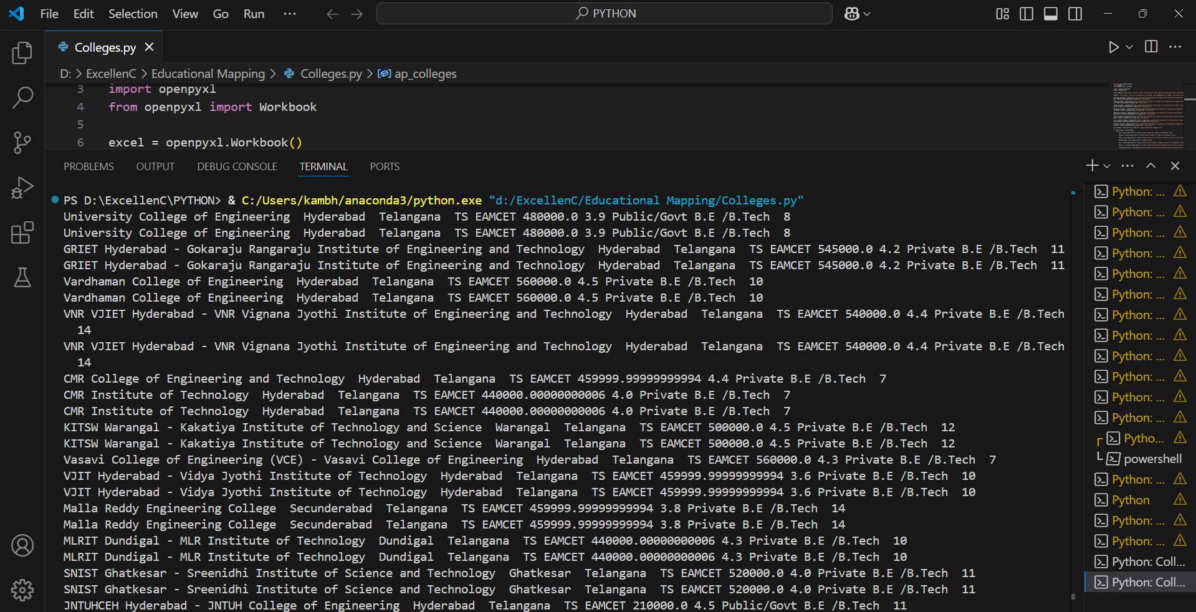
.
Step 8: Printing the classes to extract the data
print(name,location,state,entrance_exam,float(Fees)*100000,Rating,College_Affiliation,course,no_course)
# extracting the data using classes from the website
Output:

Slide 12
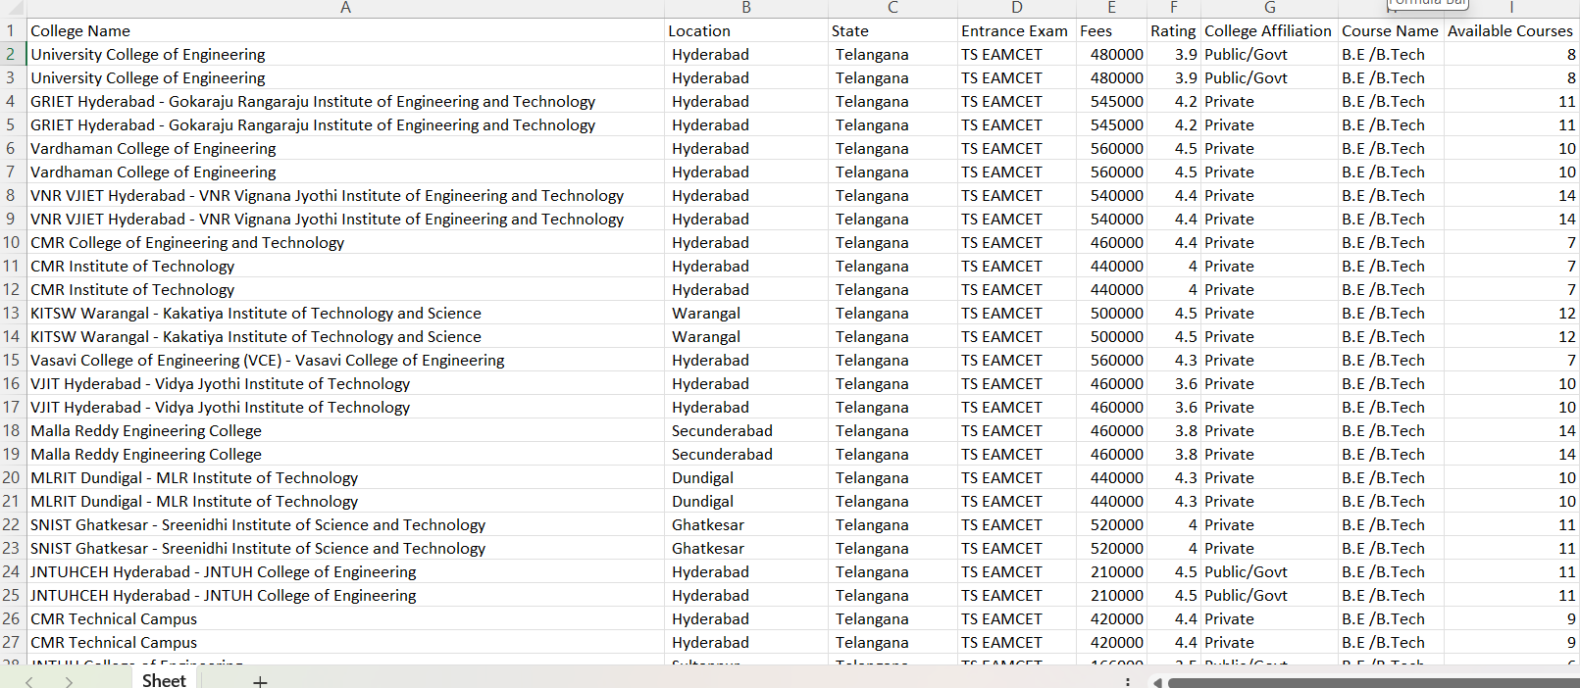
.
Step 9 : Appending data extracted to the columns in the excel sheet
sheet.append([name,location,state,entrance_exam,float(Fees)*100000,Rating,College_Affiliation,course,no_course])
except:
continue
Output:

Slide 13
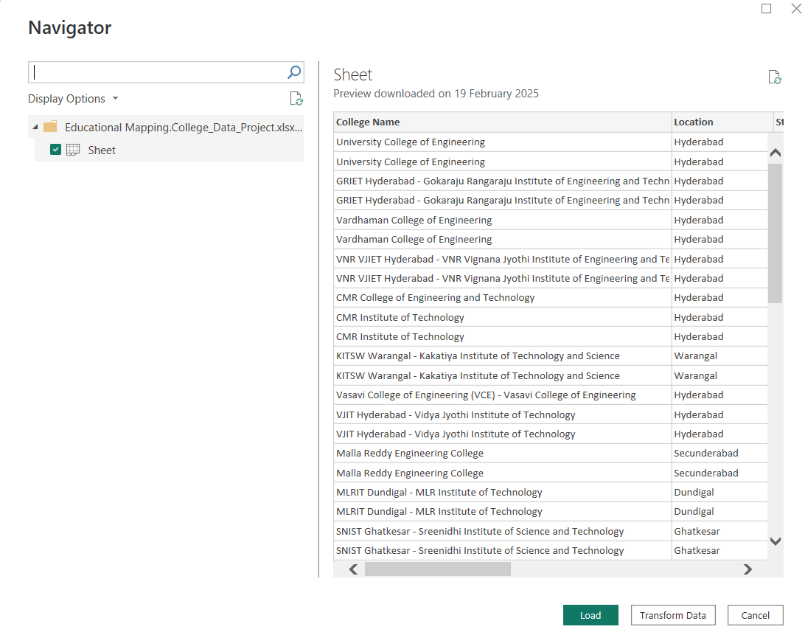
Preprocessing 1.Import Data:

Slide 14
.
Load Data: Import datasets related to College Analysis from sources like Excel, CSV files, or SQL databases into Power Bi.
Data Preview: Review the dataset in Power Bi to understand its structure, including columns such as College Name, Location, State, Entrance Exam, Fees, Rating, College Affiliation, Course Name, Available Courses.
2. Data Cleaning:
Remove Duplicates: Eliminate any duplicate entries to ensure the dataset's integrity.
Handle Missing Values: Identify Missing Values, Drop Missing Values, Impute Missing Values
Remove Rows: If null values are minimal, consider excluding rows with missing data.
Replace Values: Fill missing fields using mean, median, or default values to maintain consistency.
Correct Errors: Rectify incorrect data entries or typos to enhance accuracy.

Slide 15
.
3. Data Transformation:
Change Data Types : Update data types where necessary (e.g., ensuring numerical values for Fees or rating).
Rename Columns : Assign meaningful column names to improve readability and align with the analysis objectives.
4. Filtering:
Filter Rows: Use Power Bi’s filter options to eliminate unnecessary data. This step ensures the dataset focuses on relevant information for analysis.
5.Data Visualization:
Leverage Power Bi features to create visualizations such as bar charts, slicers, cards and Line chart to analyze Ratings, Fees, and top colleges among colleges of Andhra Pradesh, Delhi, Haryana, Karnataka, Kerala, Maharashtra, Telangana and Uttar Pradesh.
Customize dashboards for an intuitive understanding of insights.

Slide 16
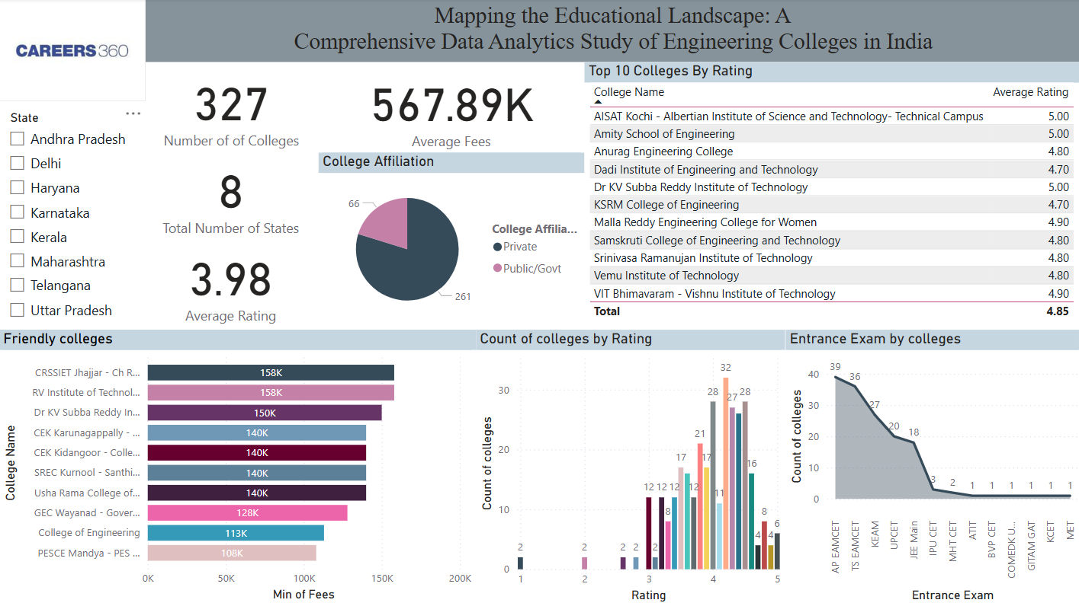
.
Dashboard

Slide 17
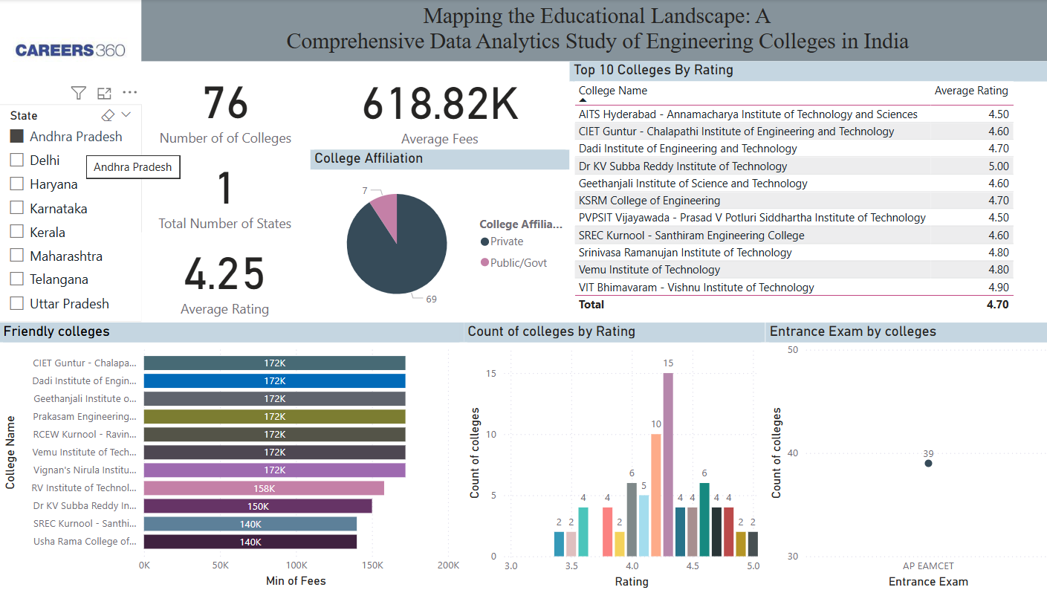
Andhra Pradesh

Slide 18
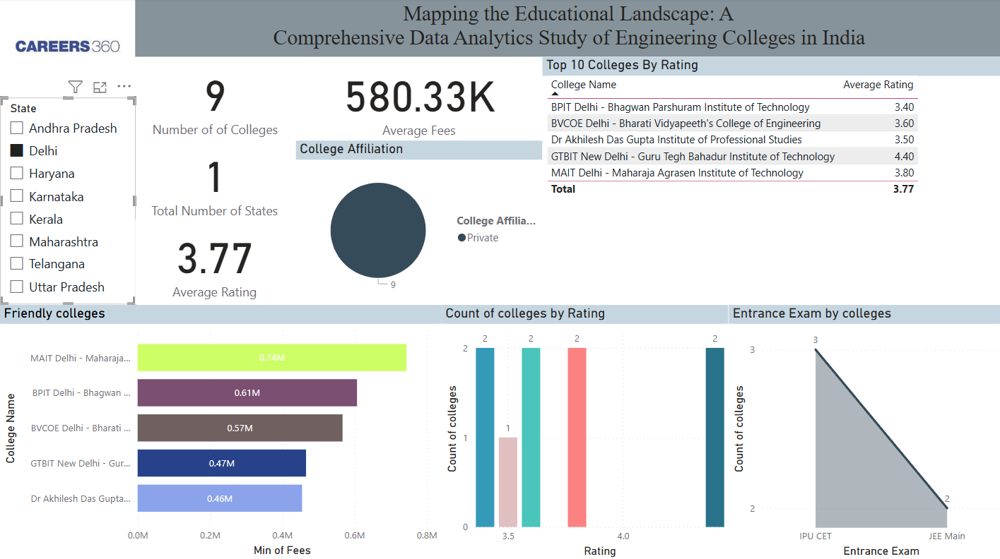
Delhi

Slide 19
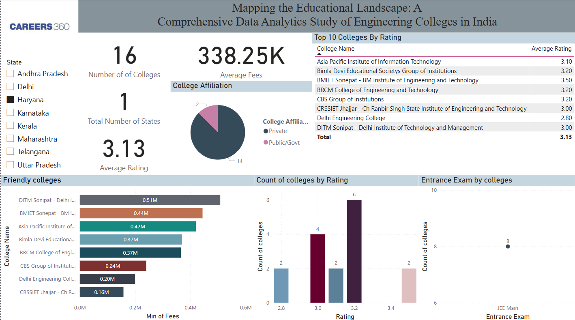
Haryana

Slide 20
Karnataka

Slide 21
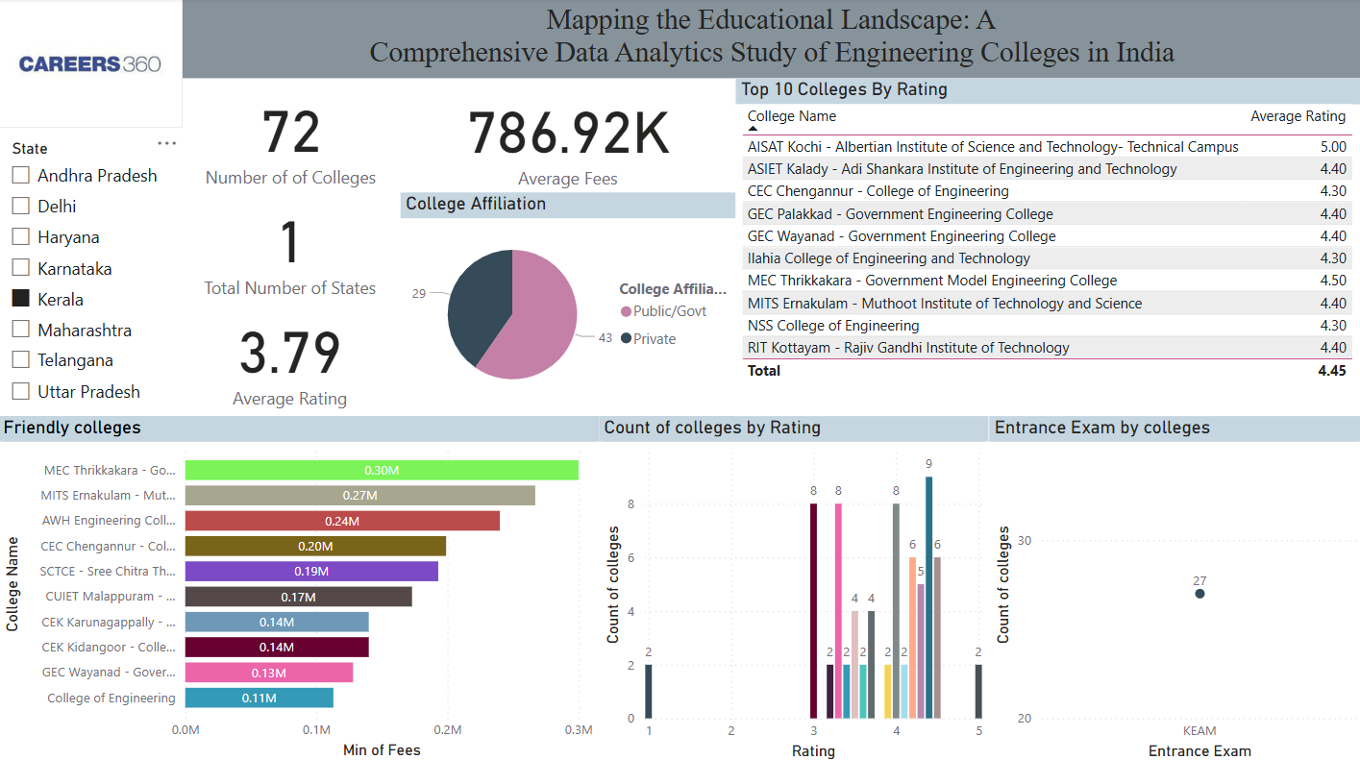
Kerala

Slide 22
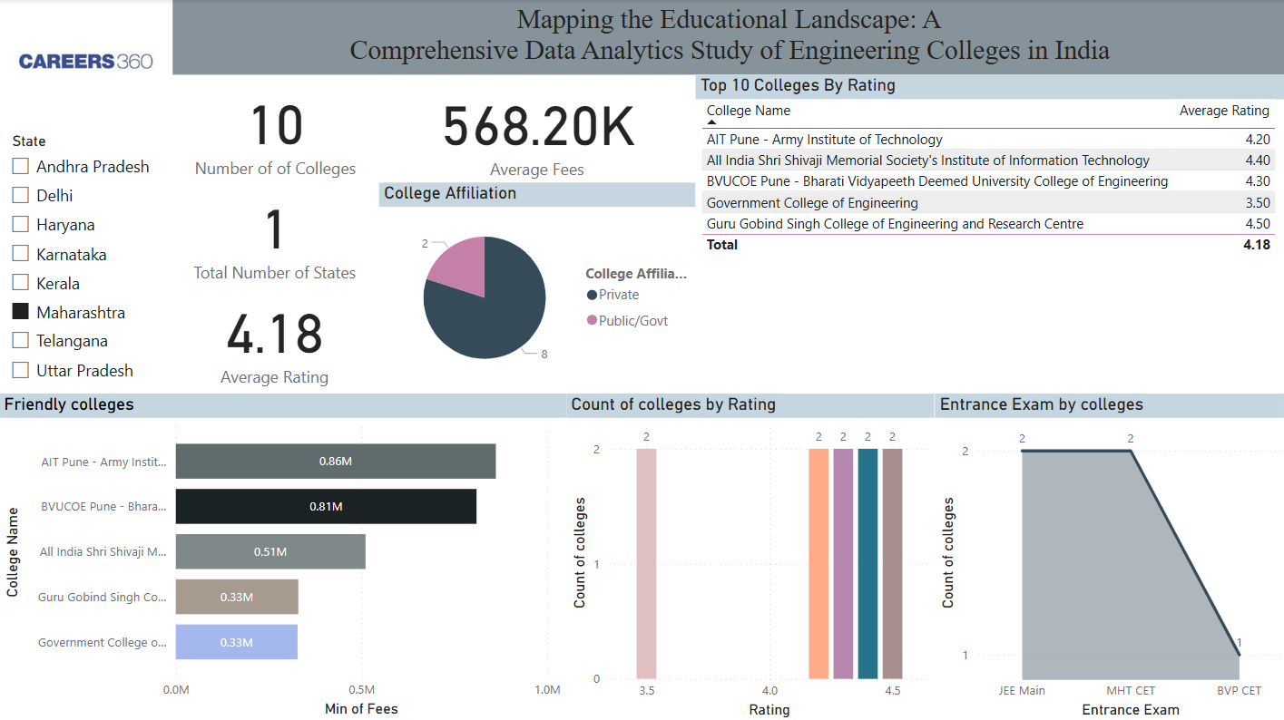
Maharashtra

Slide 23
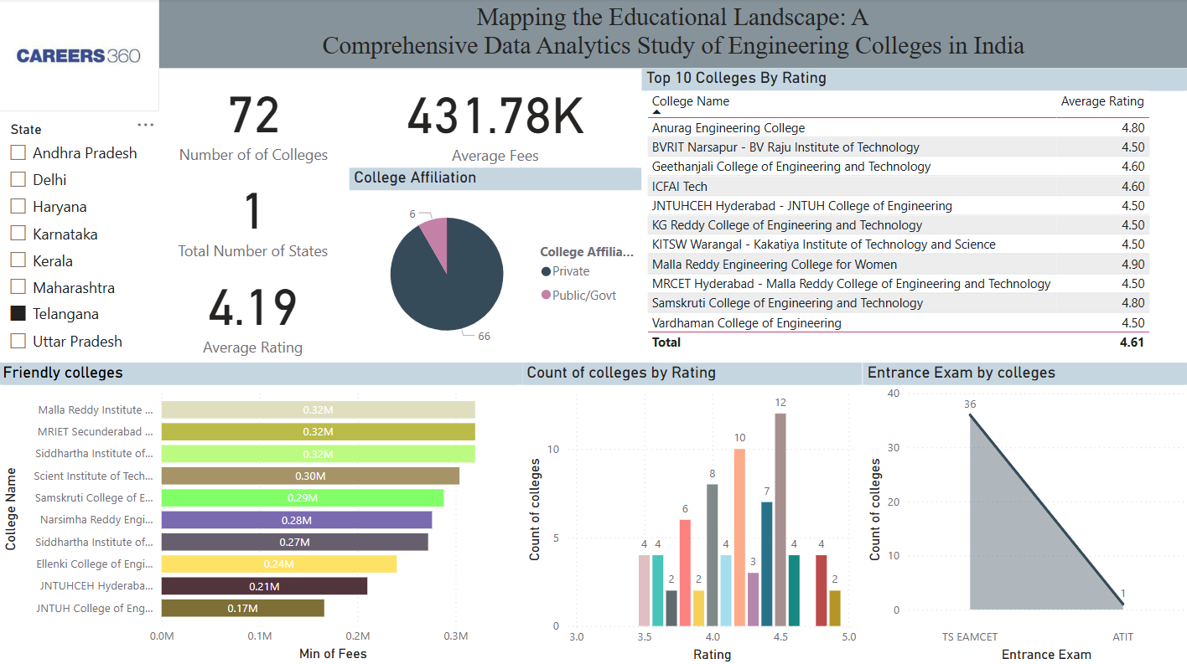
Telangana

Slide 24
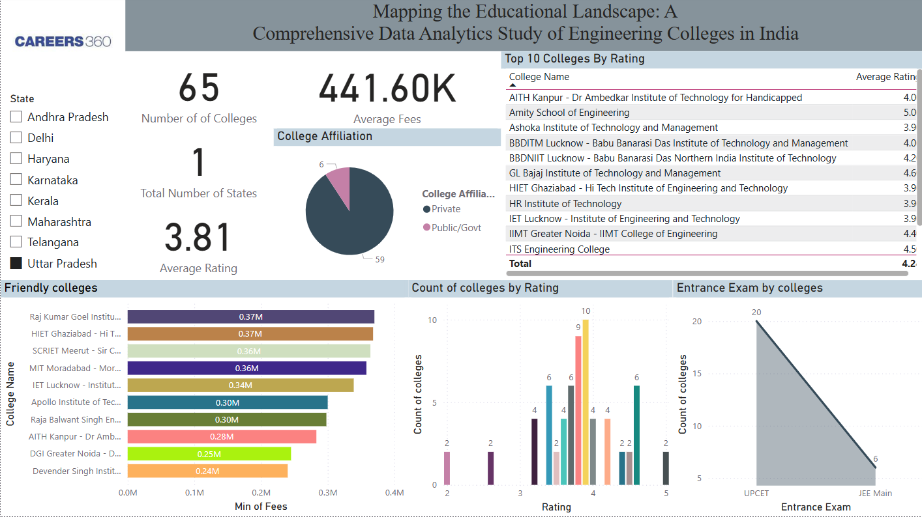
Uttar Pradesh

Slide 25

Thank You..

